Slide 1
FluId Power Systems
BY Dr. OMARI MASHI KHALFAN
MEVLANA UNIVERSITY, MECHANICAL ENGINEERING DEPT.

Slide 2
HYDRAULIC ACCUMULATOR
A hydraulic accumulator is a device used in hydraulic systems to store energy. The storage is achieved by the ability of the device in keeping hydraulic fluid at high pressures as a result of compressibility of the gas the accumulator contains.
Construction and Operation:
Basically, accumulator is a cylinder which contains two types of fluids (gas and oil) separated by a bladder, diaphragm or piston depending on the type of accumulator.
The gas portion of the device is initially filled with a gas (generally nitrogen) at a certain charge pressure, P0 then oil is filled into the liquid portion up to a maximum operating pressure required P2. Then oil is discharged as pressurized gas expands until minimum operating pressure is reached P1.

Slide 3
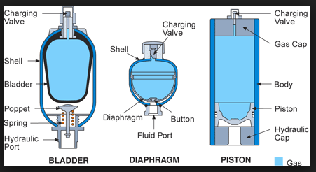
TYPES OF ACCUMULATORS

Slide 4
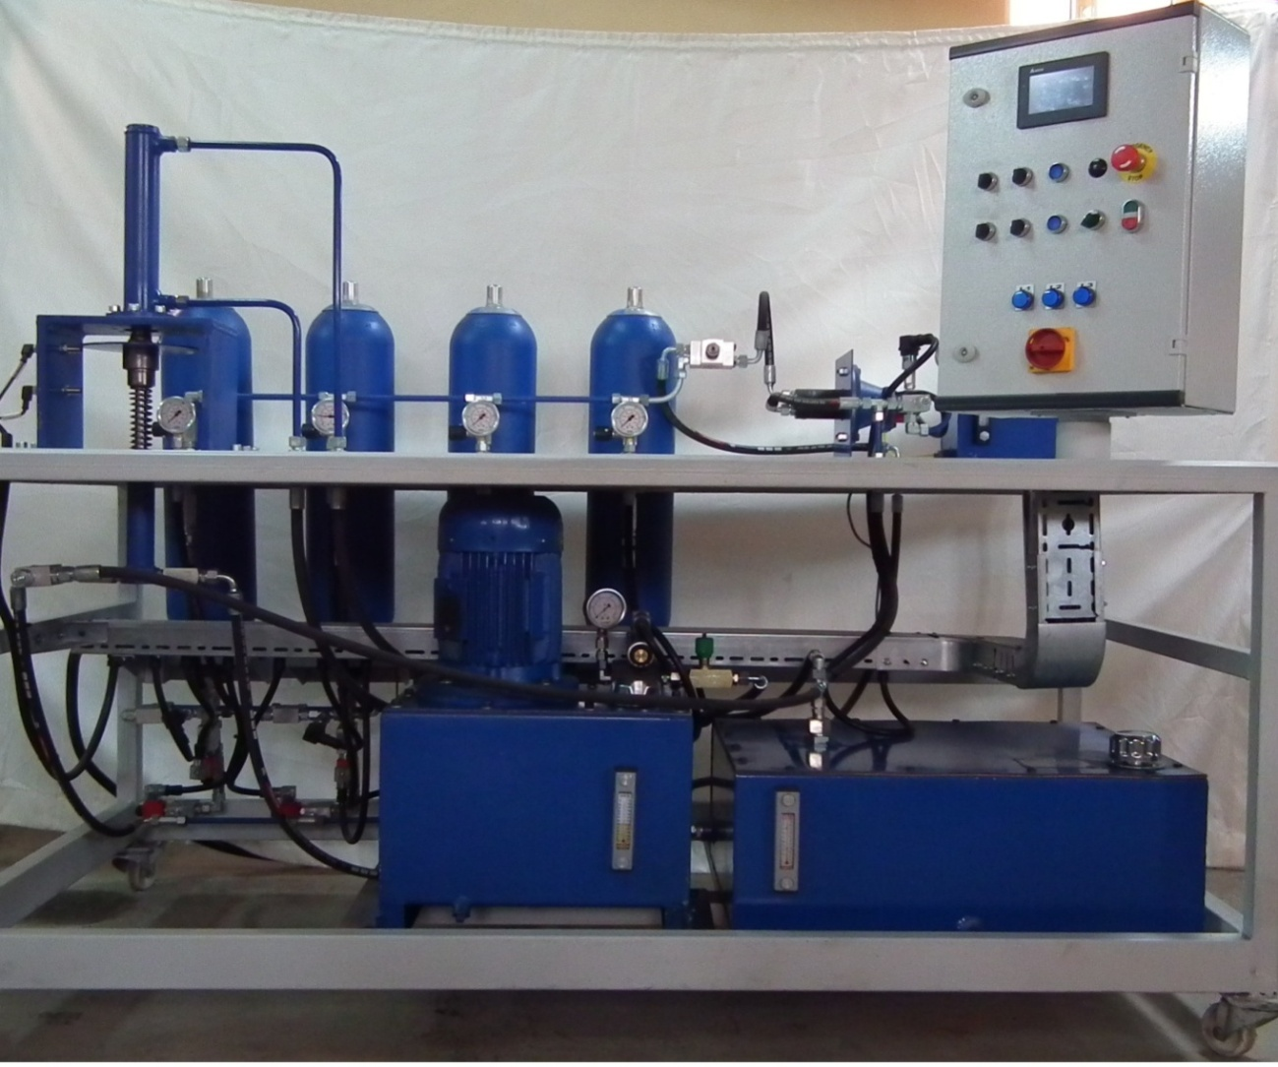
ACCUMULTORS

Slide 5
FUNCTIONS OF ACCUMULATORS
Accumulators have several functions in a hydraulic system. These are:
Energy storage . Fluid at high pressure can be stored in accumulator.
Used as a back up system in case of power failure (when no electricity the system can operate in emergency)
Provide additional volume of hydraulic oil into the system
Deadening pressure pulsation in hydraulic systems
Maintaining constant fluid flow when system demand is greater than pump supply

Slide 6
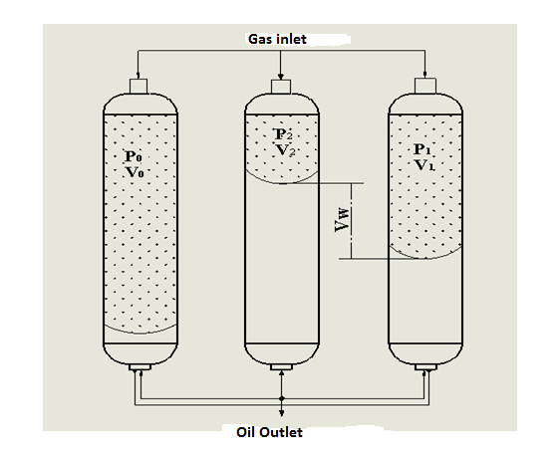
ACC-PRESSURE AND VOLUME RELATIONSHIP

Slide 7
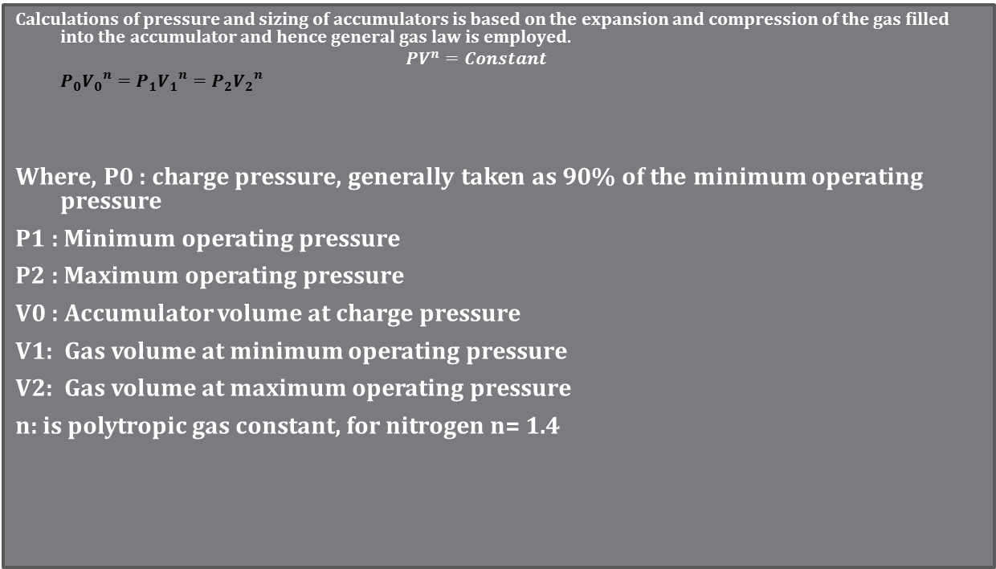
GENERAL GAS LAW
Calculations of pressure and sizing of accumulators is based on the expansion and compression of the gas filled into the accumulator and hence general gas law is employed.
$$PV^{n}=Constant$$
$$P_{0}{V_{0}}^{n}=P_{1}{V_{1}}^{n}=P_{2}{V_{2}}^{n}$$
Where, P0 : charge pressure, generally taken as 90% of the minimum operating pressure
P1 : Minimum operating pressure
P2 : Maximum operating pressure
V0 : Accumulator volume at charge pressure
V1: Gas volume at minimum operating pressure
V2: Gas volume at maximum operating pressure
n: is polytropic gas constant, for nitrogen n= 1.4

Slide 8
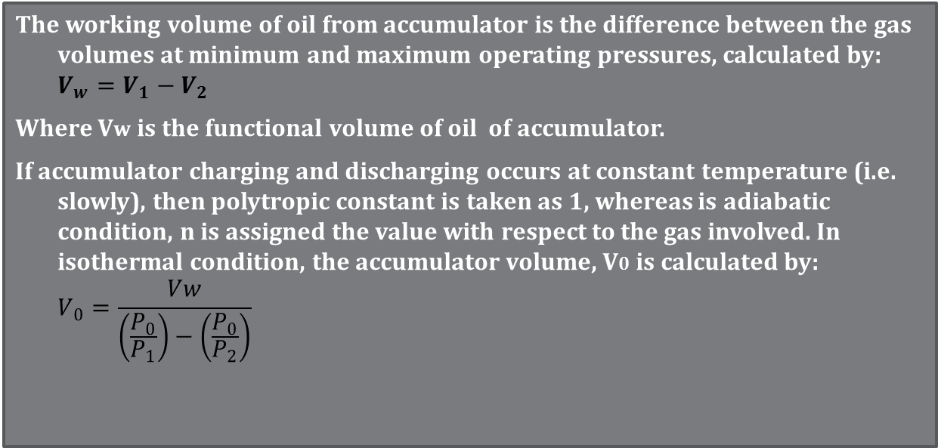
GENERAL GAS LAW
The working volume of oil from accumulator is the difference between the gas volumes at minimum and maximum operating pressures, calculated by:
$$V_{w}=V_{1}−V_{2}$$
Where Vw is the functional volume of oil of accumulator.
If accumulator charging and discharging occurs at constant temperature (i.e. slowly), then polytropic constant is taken as 1, whereas is adiabatic condition, n is assigned the value with respect to the gas involved. In isothermal condition, the accumulator volume, V0 is calculated by:
$$V_{0}=\frac{Vw}{\left(\frac{P_{0}}{P_{1}}\right)−\left(\frac{P_{0}}{P_{2}}\right)}$$

Slide 9
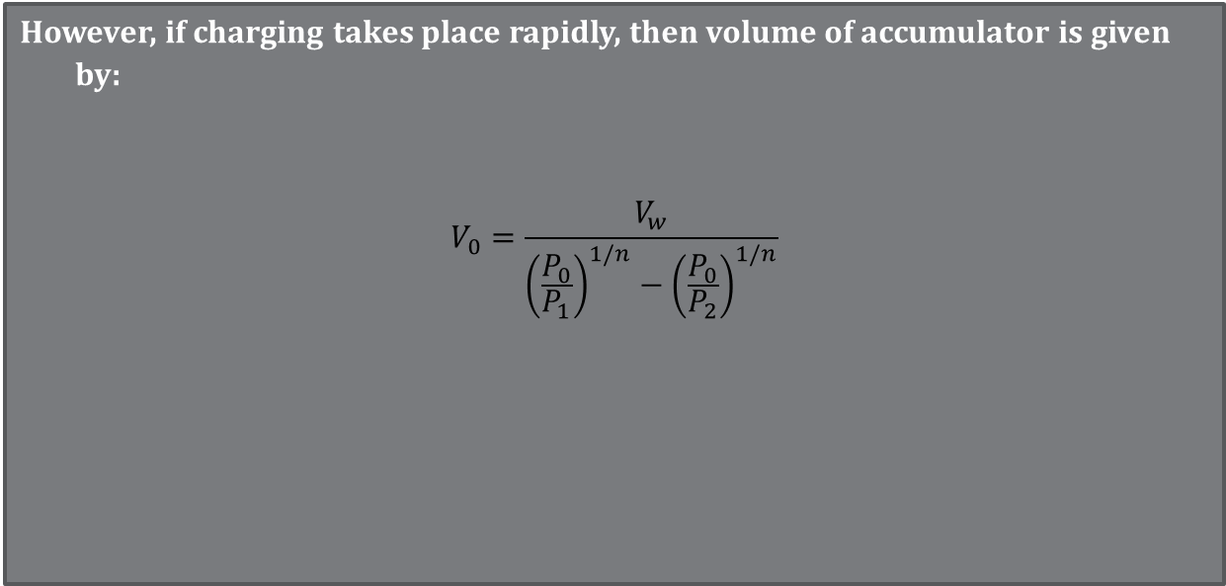
GENERAL GAS LAW
However, if charging takes place rapidly, then volume of accumulator is given by:
$$V_{0}=\frac{V_{w}}{{\left(\frac{P_{0}}{P_{1}}\right)}^{1/n}−{\left(\frac{P_{0}}{P_{2}}\right)}^{1/n}}$$

Slide 10
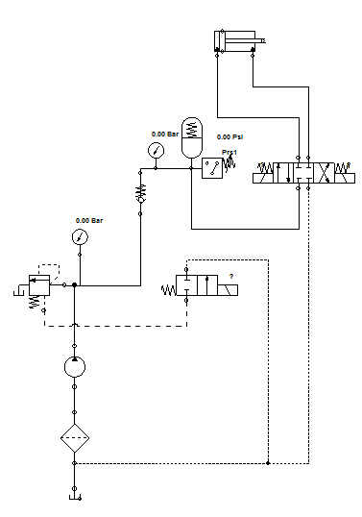
ACCUMULATOR CIRCUIT

Slide 11
example
An accumulator is to deliver 4 L of oil when ,operating between 207 bar and 110 bar in 0.8 s.
It is assumed here that the operating pressure is achieved by a slow charging process
such that the ideal isothermal process n = 1 may be assumed. If the gas used in the bladder has n=1.82. What is the size of the accumulator?
Solution:
Given :P2= 207 bar, P1=110 bar, n= 1.82 therefore pre-charge pressure, P0= 90% P1 = 110(0.9)=99 bar.

Slide 12
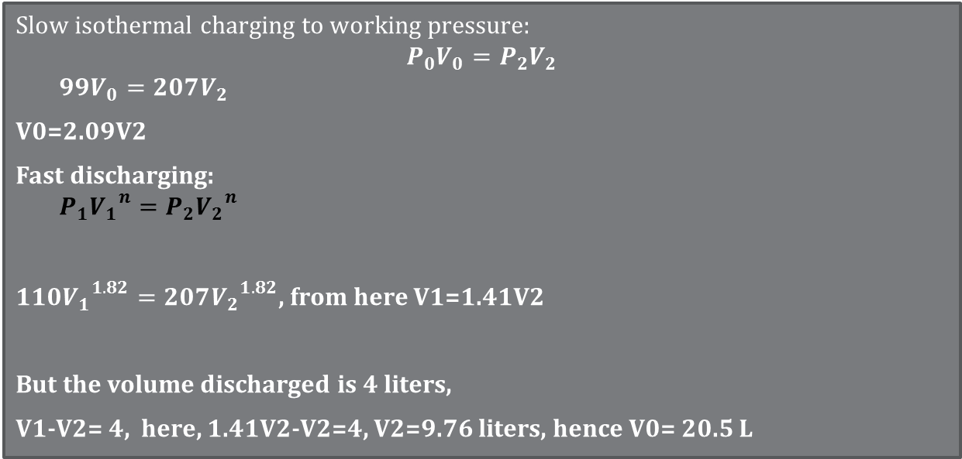
Slow isothermal charging to working pressure:
$$P_{0}V_{0}=P_{2}V_{2}$$
$$99V_{0}=207V_{2}$$
V0=2.09V2
Fast discharging:
$$P_{1}{V_{1}}^{n}=P_{2}{V_{2}}^{n}$$
$110{V_{1}}^{1.82}=207{V_{2}}^{1.82}$, from here V1=1.41V2
But the volume discharged is 4 liters,
V1-V2= 4, here, 1.41V2-V2=4, V2=9.76 liters, hence V0= 20.5 L

Slide 13
FLUID POWER COMPONENTS
1. HYDRAULIC PUMP
Pumps in hydraulic systems are used to convert mechanical energy to fluid energy.
There are basically three types of pumps used in hydraulic systems:
i) Gear Pumps-(external, internal and gerotor gear pumps)
ii) Vane Pumps
iii) Piston Pumps

Slide 14
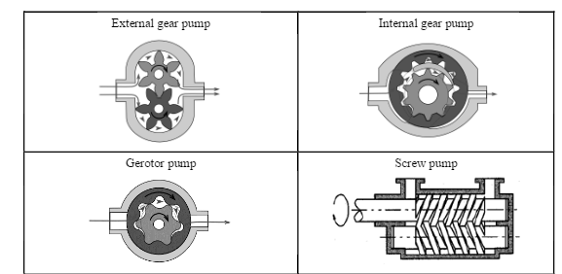
TYPES OF HYDRAULIC PUMPS

Slide 15
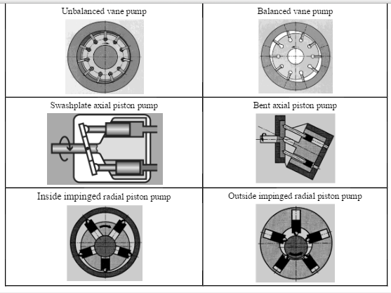
TYPES OF HYDRAULIC PUMPS

Slide 16
TYPES OF HYDRAULIC PUMPS
Gear Pumps
Gear pumps are low cost types of pumps which always operate as constant (fixed) displacement pumps in hydraulic systems. They are available as external gear, internal gear and gerotor types.
They operate at relatively lower operating pressures as compared to the other types of pumps in the field. This is due to leakage through the gear teeth as operating pressures increase.
Therefore, these types of pumps are used when the operating pressure required for a system is not too high. Typically at a maximum value of 250 Bar.

Slide 17
Vane Pumps:

Slide 18
WHAT IS FLUID POWER?
Fluid power refers to transmission and control of energy by means of pressurized fluid. The term fluid designates liquid or gas. If the fluid power system involves liquid, it’s called Hydraulic System but, if the medium used in the fluid power system is air (gas) then the system is known as a Pneumatic System.
Essentially fluid power is used for convenience in converting mechanical power to fluid power and back to mechanical power.
There are three types of power transmission systems:
1. Mechanical power transmission system (gear boxes, pulleys, levers)
2. Electrical power transmission system (cables, wires)
3. Fluid power system (fluid)

Slide 19
ADVANTAGES OF FLUID POWER
Fluid power systems offer high power at correspondingly small weights of its components
Easy and accurate control of actuators.
Actuators in fluid power can have enormous speed range and be reversed when needed.
Capable of producing a high and constant torque regardless of speed changes.
Single source of fluid power (pump) is capable of operating several systems at once
Can be operated at hazardous environments

Slide 20
DISADVANTAGES OF FLUID POWER
Leakage and pump cavitation in hydraulic systems tend to lower their efficiency
The system needs careful handling against particle contamination hence filtering is necessary

Slide 21
WHAT IS THE MAGIC BEHIND FLUID POWER SYSTEMS?
The secrecy behind fluid (in this case, liquid) being able to multiply force and hence become capable of accomplishing useful work lies under two facts:
Pascal Theory
Incompressibility of Liquid

Slide 22
1. PASCAL THEORY
Pascal Theory states that pressure of an incompressible fluid in a confined system travels undiminished at every point within the system.
That means, if we put a liquid in a container and apply force at one point, the force will create some sort of pressure over the area where the force has been applied and that pressure will be the same everywhere within the confined liquid.
Mathematically; the theory can be expressed as:
P = F / A
Where ;
P is pressure defined as force per unit area and measured in Newtons per square metres (N/m² which is equivalent to Pascal Pa).
F is the applied force in Newtons (N)
A is the area in square metres (m² ) over which the force is applied.

Slide 23
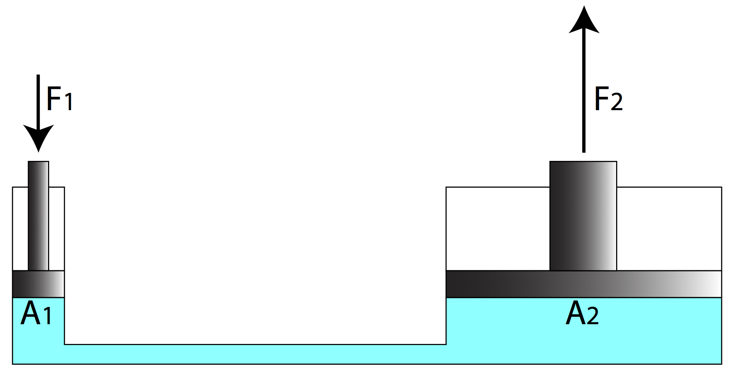
DEMOSTRATING APPLICATION OF PASCAL THEORY [1]

Slide 24
DEMOSTRATING APPLICATION OF PASCAL THEORY
The above pictorial presentation shows application of the Pascal Theory where a small force of F₁ is applied on a confined fluid over an area of A₁, but the pressure created on the fluid can be used to obtain large force of magnitude F₂ if the fluid is allowed to act on a large area, A₂.
Here ,we can see that the hydraulic system can be used to multiply force in the sense that a small force can be applied over a small area (for instance a hydraulic hose), but by making use of the Pascal Theory, the pressure created by the small force within the liquid can be exposed over a relatively large area (for instance on a piston of a hydraulic cylinder) and thus resulting in a very large force.
In this context, the concept can be termed as a mechanical advantage of the hydraulic system.

Slide 25
Another factor that enables fluid power systems to demonstrate wonders in today’s sophisticated industrial applications is their tendency to resist shear forces. We can’t simply cut through a confined fluid. The fluid will tend to move (thereby pushing anything along its way) as far as its compressibility allows it.
This is particularly the case in Hydraulics, where the liquid used (hydraulic oil) generally shows negligible change in its density and hence considered incompressible.
In other words, we can apply high pressures on Hydraulic systems (between 100 and 350 Bars) which can result in higher forces necessary for lifting, lowering, compacting, forming or pushing applications without affecting the force transmitting medium (hydraulic oil) in the system.

Slide 26
2.INCOMPRESSIBILITY OF LIQUID
On the other hand, Pneumatic systems have limited pressure ranges (around 2 to 8 Bar). This is due to the fact that air is compressible, therefore only applications involving relatively lower pressures can be handled nicely with Pneumatic systems.
But pneumatic systems have the advantage of having quick responses than their hydraulic counterparts.
Due to their light and simple construction, Pneumatic components are cheaper than hydraulic system components.

Slide 27
BASIC HYDRAULIC SYSTEM
Generally speaking, a basic hydraulic system consists of the following components:
Hydraulic pump
Prime mover to drive the pump
Pressure relief valve to protect the system against extreme pressures
Control valve to route the oil to the actuators
Actuators (users) that use fluid pressure to do mechanical works
Hydraulic tank to store the fluid
Fittings and Hoses to help conveying the fluid to required points.

Slide 28
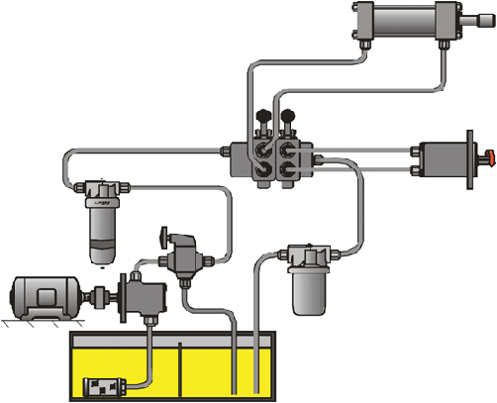
HYDRAULIC SYSTEM WITH TWO ACTUATORS [3]
Directional Control Valve
Pressure Line Filter
Actuators
Pump
Return Filter
Electric Motor
Pressure Relief Valve
Suction Strainer

Slide 29
FUNCTIONS OF COMPONENTS IN A HYDRAULIC SYSTEM
Pump is among the most important components in a hydraulic system. Its function is to create flow of the hydraulic oil to the system.
Prime Mover; this refers to electric motor or an internal combustion engine whose function is to provide mechanical energy to drive the pump.
Suction Strainer, it’s a means of filtering. The device filters coarse solid materials and prevent them from reaching the pump.
Actuators; these are devices that use the fluid pressure and velocity to do mechanical works. They are either linear actuators known as cylinders or rotary actuators termed as hydraulic motors.
Coolers; Hydraulic systems are almost always susceptible to overheating . This is prevented by incorporating an oil cooling device to lower the operating temperatures of the liquid.

Slide 30


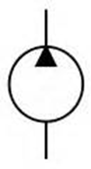
Hydraulic Circuit Symbols
Hydraulic system components are represented by their internationally recognized symbols. Some of these symbols are shown below:
Hydraulic Tank (reservoir)
Variable Displacement Pump
Fixed Displacement Pump

Slide 31




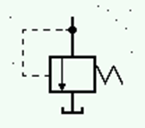


Hydraulic Circuit Symbols
Hydraulic line Flexible line
Pilot line line connection
Filter
Pressure Relief Valve
Two way – two position valve (2/2)
Four way, three position valve (4/3)

Slide 32
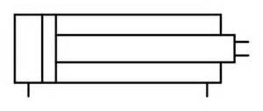
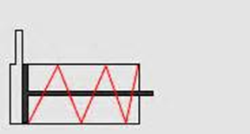
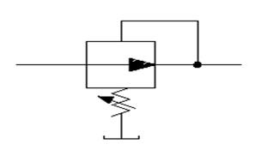
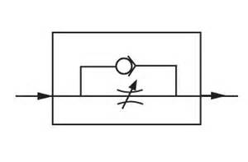
Hydraulıc Cırcuıt Symbols
Double acting cylinder
Single acting cylinder
Pressure reducing valve
Flow control valve + check valve

Slide 33
HYDRAULIC CIRCUITS
Hydraulic circuits are schematic representations of the components used in a hydraulic system and their inter-relations on the functioning of the system as a whole.
They give an insight of which devices the system contains.
They also help in troubleshooting if the system develops a breakdown and someone else has to deal with the problem.

Slide 34
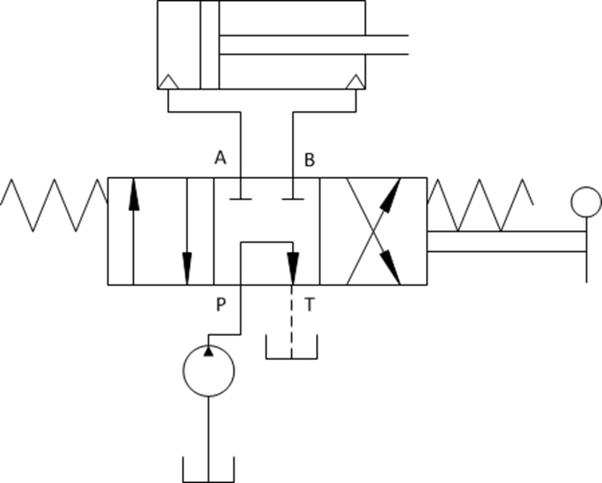
Simple Hydraulic Circuit
Pump+4/3 tandem centre manual valve + double acting cylinder

Slide 35
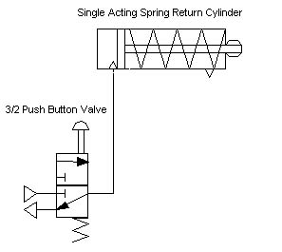
Actuating a single acting cylinder
Single acting cylinder + 3/2 direction valve
Pneumatic System
Hydraulic System

Slide 36
Pump Unloadıng Cırcuıt
This type of hydraulic circuit is used to unload pump (i.e. directing pump flow to tank at a low pressure) when a required pressure in the system is reached. It incorporates an unloading valve which principally operates as a pressure relief valve but at a relatively lower pressure. This circuit is used:
when an accumulator is used with a closed centre valve, or
when two pumps (high-low) are used together and one is to be unloaded after a certain pressure value .

Slide 37
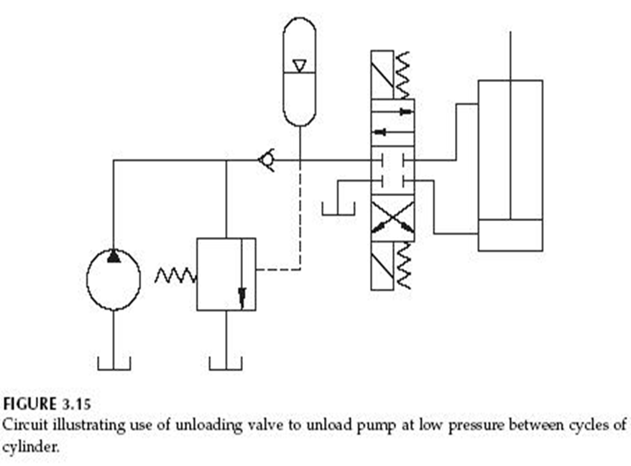
1.UnloadIng CIrcuIt wIth Accumulator
Accumulator
Unloading Valve

Slide 38
2. Unloading Valve with Hi-lo Pumps
Pressure Relief Valve
Unloading Valve

Slide 39
Cylinder Locking Circuit
In most heavy duty hydraulic presses, the press table connecting the cylinder needs to be locked in place when the press is off duty. This is achieved by incorporating a double check pilot operated valve in the system. In this way, the table (cylinder) remains in its required position and no external load (such as the table’s weight) can move it.

Slide 40
Cylinder Locking Circuit
Pilot Operated Double Check Valve

Slide 41
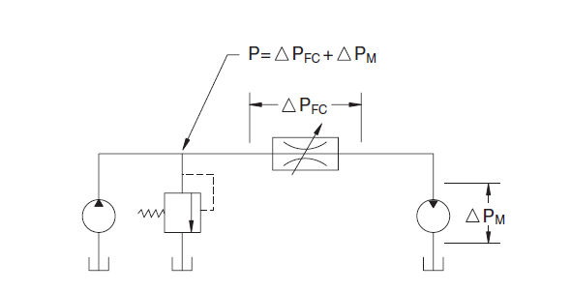
FLOW CONTROL EXAMPLE

Slide 42
PRESSURE VALVES
From the circuit above, if the pump supplies 10 litres/min to the motor and the pressure at the relief valve is 70 Bar. What pressure drop must be established at the flow control valve in order to reduce the motor speed to half of its current value? Assume that system pressure increases to 120 Bar before the relief valve opens.
Flow to the motor must be reduced to 5 litres /min to cut the speed by half,
which means that 5 litres/min must flow across the relief valve. pressure must rise to 120 Bar before 5 litres/min bypasses through the relief
valve. Pressure drop across the motor is only 70 Bar; therefore, the required
pressure drop across the flow control valve must be 120-70= 50 Bar

Slide 43
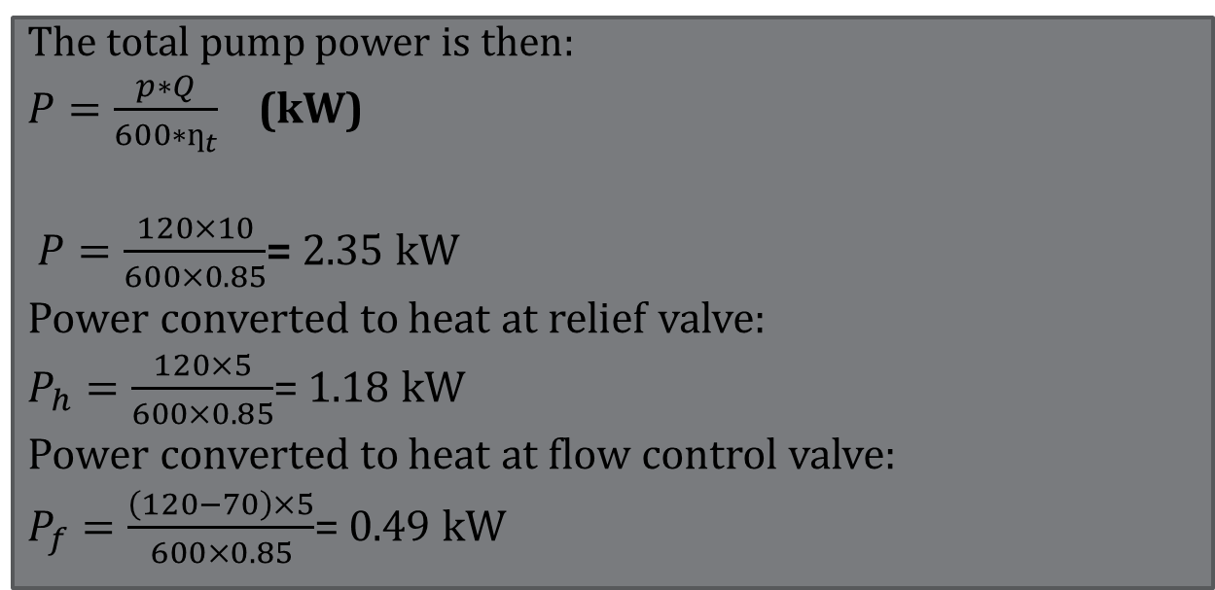
FLOW VALVES
The total pump power is then:
$P=\frac{p∗Q}{600∗ƞ_{t}}$ (kW)
$P=\frac{120×10}{600×0.85}$= 2.35 kW
Power converted to heat at relief valve:
$P_{h}=\frac{120×5}{600×0.85}$= 1.18 kW
Power converted to heat at flow control valve:
$P_{f}=\frac{\left(120−70\right)×5}{600×0.85}$= 0.49 kW

Slide 44
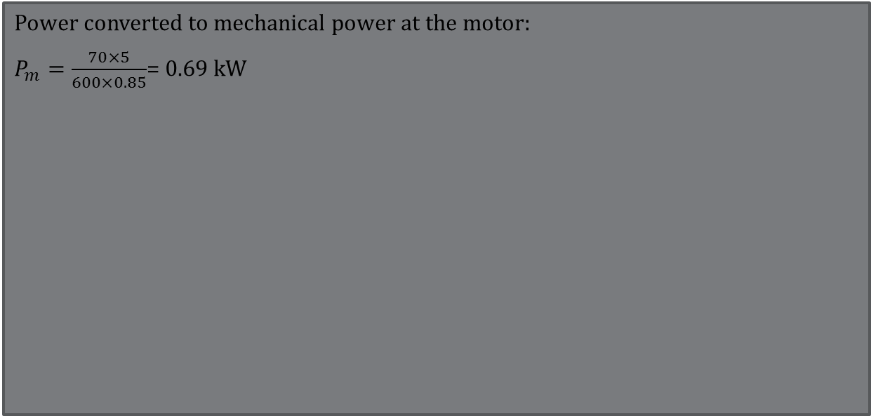
FLOW VALVES
Power converted to mechanical power at the motor:
$P_{m}=\frac{70×5}{600×0.85}$= 0.69 kW

Slide 45
HEAT GENERATION AND DISSIPATION
In hydraulic system, heat is among the most effective causes of system failure and malfunctioning.
It should be noted that whenever there is pressure drop in a hydraulic system and no mechanical work is done, then heat is generated in the system.
Among components that cause heat generation in hydraulic system are:
Pressure relief valve
Pressure reducing valve
Counterbalance valve
Flow control valves
Pumps and motors

Slide 46
HEAT GENERATION AND DISSIPATION
Pressure drops also occur in long pipes and fittings ; however if suitable lengths are selected, then pressure drops and consequent heat generation is reduced.
Other causes of heat generation include:
1. Use of small diameter pipes for higher oil flow rates
2. Poor design of hydraulic reservoir (i.e. small tank with poor air circulation)
Whenever the heat generated exceeds the rate of heat dissipation then the system will overheat.
In such cases, a heat exchanger should be incorporated to cool down the system. Heat exchangers are of two types
Shelled tube heat exchangers (water or oil cooled)
Finned tube heat exchangers (air cooled)

Slide 47
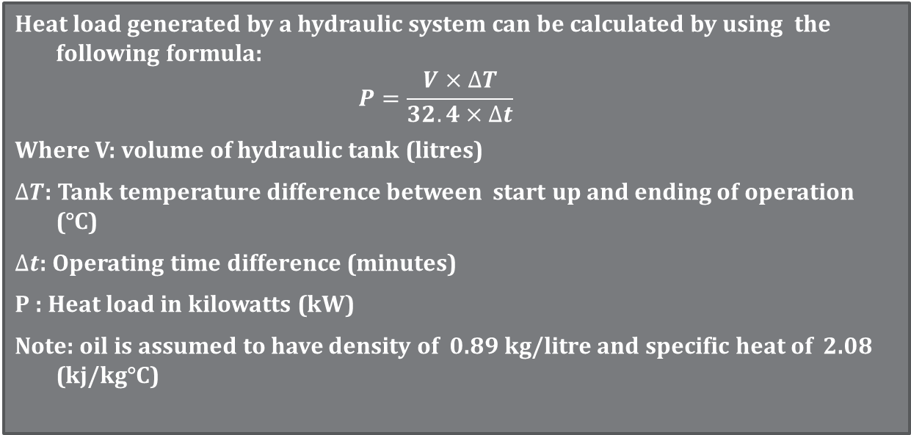
HEAT GENERATION AND DISSIPATION
Heat load generated by a hydraulic system can be calculated by using the following formula:
$$P=\frac{V×∆T}{32.4×∆t}$$
Where V: volume of hydraulic tank (litres)
$∆T$: Tank temperature difference between start up and ending of operation (°C)
$∆t$: Operating time difference (minutes)
P : Heat load in kilowatts (kW)
Note: oil is assumed to have density of 0.89 kg/litre and specific heat of 2.08 (kj/kg°C)

Slide 48
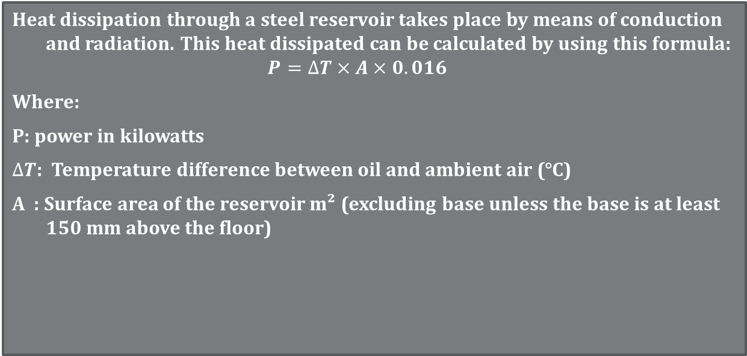
HEAT GENERATION AND DISSIPATION
Heat dissipation through a steel reservoir takes place by means of conduction and radiation. This heat dissipated can be calculated by using this formula:
$$P=∆T×A×0.016$$
Where:
P: power in kilowatts
$∆T$: Temperature difference between oil and ambient air (°C)
A : Surface area of the reservoir m² (excluding base unless the base is at least 150 mm above the floor)

Slide 49
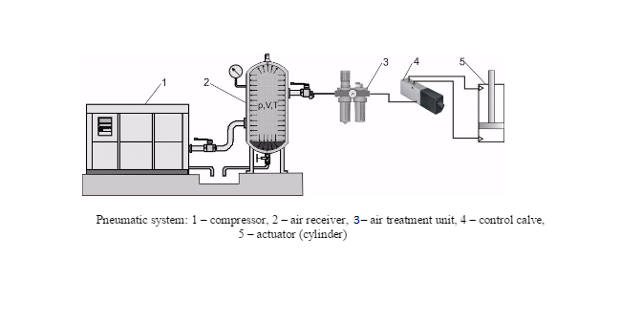
PNEUMATIC SYSTEM

Slide 50
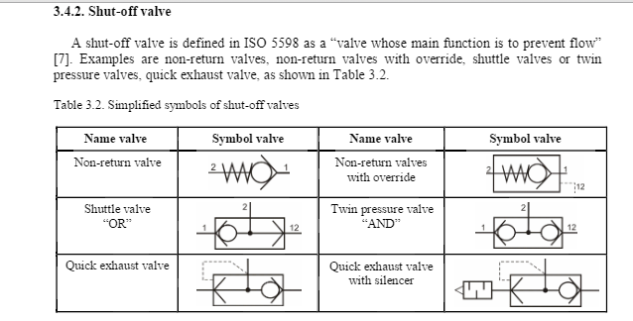
SHUT-OFF-VALVES

